Slide 1
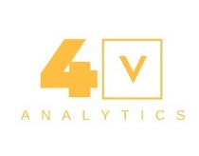
Python Programming Language Data Science Everything in-between

Slide 2
Presentation Overview
Why Python
IDE
Why Jupyter Notebook
Why Anaconda
Python Programming Langauge
What else?
Notes:
NoteBooks
Functional programming: Variables, Lists, Arrays, Loops, Functions, Classes
Dictionaries
Tuples
Mutable

Slide 3
Why Python
General-purpose language
Great for backend
Web development
Data analysis
Artificial intelligence
Scientific computing
Plenty of resources

Slide 4

Why Python…
Beginner Friendliness
Easy to Understand >> print(hello word)
Very Flexible >> a = 10
Scalability (because of dynamically typed language)
Community
5th Largest StackOverflow Community
3rd Largest Meetup Community
4th Most-Used Language at GitHub
Career Opportunities
I’m not supposed to tell you that
Future

Slide 5
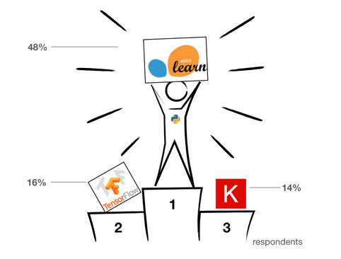
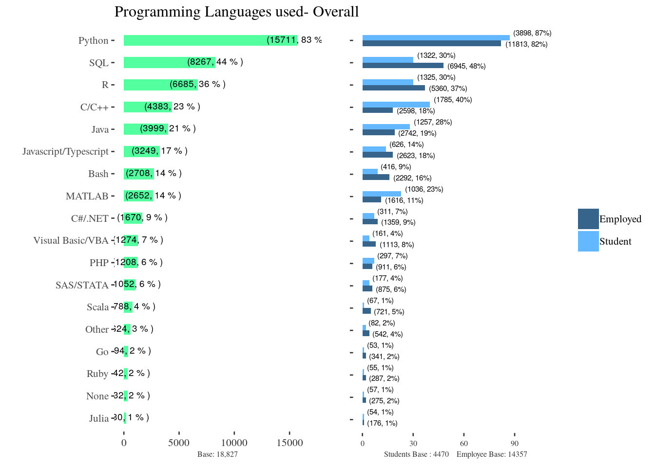
Why Python…
Source: State of ML, Kaggle Survey
Notes:
5 means best

Slide 6
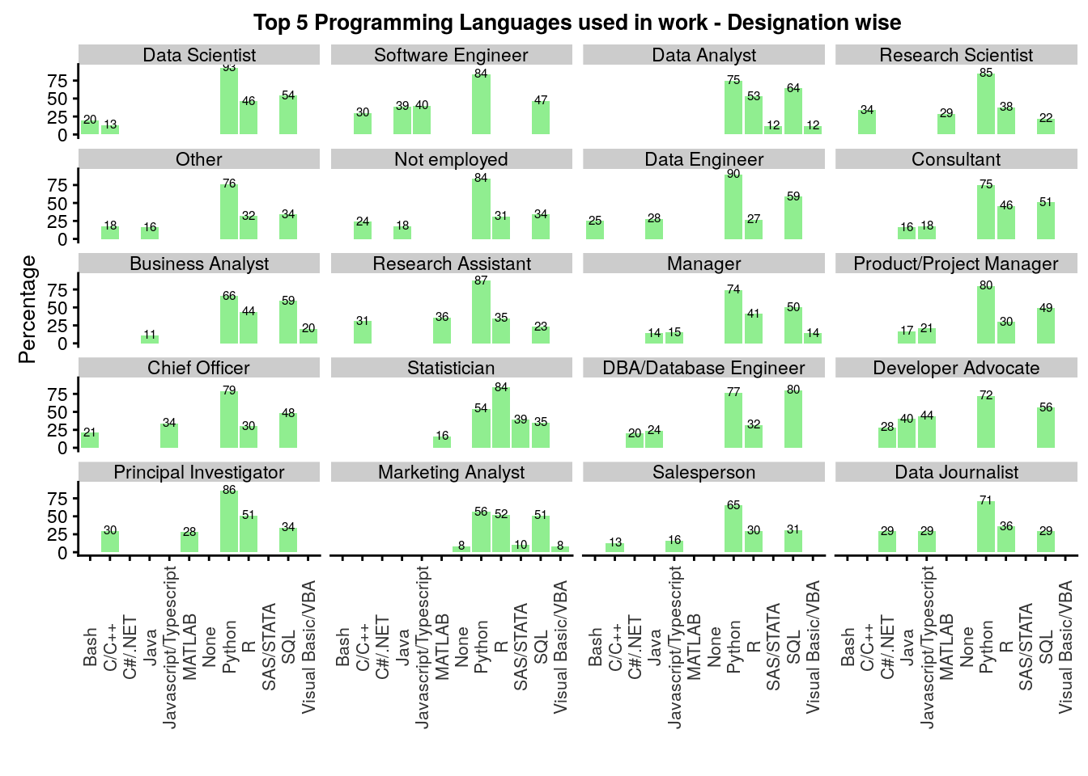
Why Python…
Notes:
5 means best

Slide 7
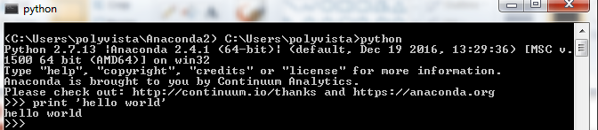
IDE (Console Based)

Slide 8
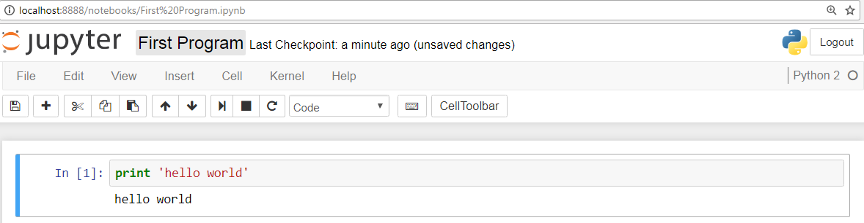
IDE (Jupyter Notebook)

Slide 9
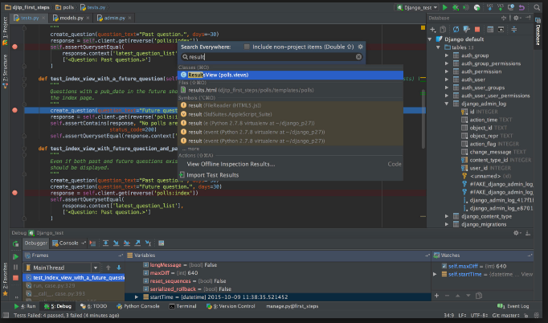
IDE (PyCharm)

Slide 10
Jupyter NoteBooks
Jupyter Notebook App (formerly IPython Notebook) is an application running inside the browser.
A web application which allows you
To create and share documents
That can contain live code, text, visualizations
Easy to jumpstart
Brings together an analysis and it’s results
Offers real time data analysis
Notes:
docker run --rm -it -p 8888:8888 -v "$(pwd):/notebooks" jupyter/not
https://www.datacamp.com/community/tutorials/tutorial-jupyter-notebook#gs.PU2kftE
What is a jupyter notebook Running the jupyter notebook https://jupyter-notebook-beginner-guide.readthedocs.io/en/latest/execute.html
https://unidata.github.io/online-python-training/notebook.html

Slide 11
Why Anaconda
It comes with many powerful packages
While traditional Python gives you just a basic platform where you have to install your desired packages manually

Slide 12
Python Programming Language
Data Types, Operators
String
List
Dictionary
Functions
Other Utility Functions

Slide 13
Python: Variables
Reserved memory locations to store values
You do not need explicit declaration of type
Happens automatically when you assign a value to a variable
counter = 60 # An integer assignment
miles = 1000.0 # A floating point
name = “Ali" # A string
Multiple assignment ( a single val to * var simultaneously)
x = y = z = 1
x, y, z = 1,2, “Ali” (* objects to * variables)
Notes:
http://www.thegeekstuff.com/2013/04/python-introduction/
Estimating prices of a used cars

Slide 14
Arrays
One of basic Data Structures in any language
Python doesn't have a native array data structure, but it has the list
which is much more general and can be used as a multidimensional array
A list in Python is just an ordered collection of items which can be of any type

Slide 15
Python: Lists
A container that holds a number of other objects
Add/remove objects from list
Create
Access
Looping over list
Modify lists (Insert, append, extend)
Searching lists
Sorting and printing
Notes:
http://www.thegeekstuff.com/2013/06/python-list/?utm_source=feedly
http://effbot.org/zone/python-list.htm
mylist = []mylist.append(1)mylist.append(2)mylist.append(3)print(mylist[0]) # prints 1print(mylist[1]) # prints 2print(mylist[2]) # prints 3# prints out 1,2,3for x in mylist: print(x)

Slide 16
Python: Lists…
mylist =[]
mylist.append(1)
mylist.append(2)
mylist.append(3)
print(mylist[0]) # prints 1
print(mylist[1]) # prints 2
print(mylist[2]) # prints 3
# prints out 1,2,3 for x in mylist: print(x)

Slide 17
Numpy Arrays
Numpy arrays are great alternatives to Python Lists.
Some of the key advantages of Numpy arrays are that they are fast, easy to work with, and give users the opportunity to perform calculations across entire arrays.
# Create 2 new lists height and weight
height = [1.87, 1.87, 1.82, 1.91, 1.90, 1.85]
weight = [81.65, 97.52, 95.25, 92.98, 86.18, 88.45]
# Import the numpy package as np
import numpy as np
# Create 2 numpy arrays from height and weight
np_height = np.array(height)
np_weight = np.array(weight)
Another great feature of Numpy arrays is the ability to subset. For instance, if you wanted to know which observations in our array are above 23, we could quickly subset it to find out. # Print only those observations above 23
weight[weight > 90]

Slide 18
Loops
There are two types of loops in Python, for and while.
Iterate over a given sequence
primes = [2, 3, 5, 7] for prime in primes: print(prime)
Repeat as long as a certain boolean condition is met
count = 0
while count < 5:
print(count)
count += 1 # This is the same as count = count + 1
break is used to exit a for loop or a while loop, whereas continue is used to skip the current block, and return to the "for" or "while" statement.
Notes:
# Prints out 0,1,2,3,4 and then it prints "count value reached 5"count=0while(count<5): print(count) count +=1else: print("count value reached %d" %(count))# Prints out 1,2,3,4for i in range(1, 10): if(i%5==0): break print(i)else: print("this is not printed because for loop is terminated because of break but not due to fail in condition")

Slide 19
Functions
An easy way to divide your code into useful blocks
Enhance readability, reuse
Key way to define interfaces so programmers can share their code
Functions may also receive arguments (variables passed from the caller to the function)
Functions may return a value to the caller, using the keyword- 'return‘
Calling a function : my_function()

Slide 20
Functions
def my_function():
print("Hello From My Function!")
def my_function_with_args(username, greeting):
print(“Hello”, username, greeting)
def sum_two_numbers(a, b):
return a + b

Slide 21
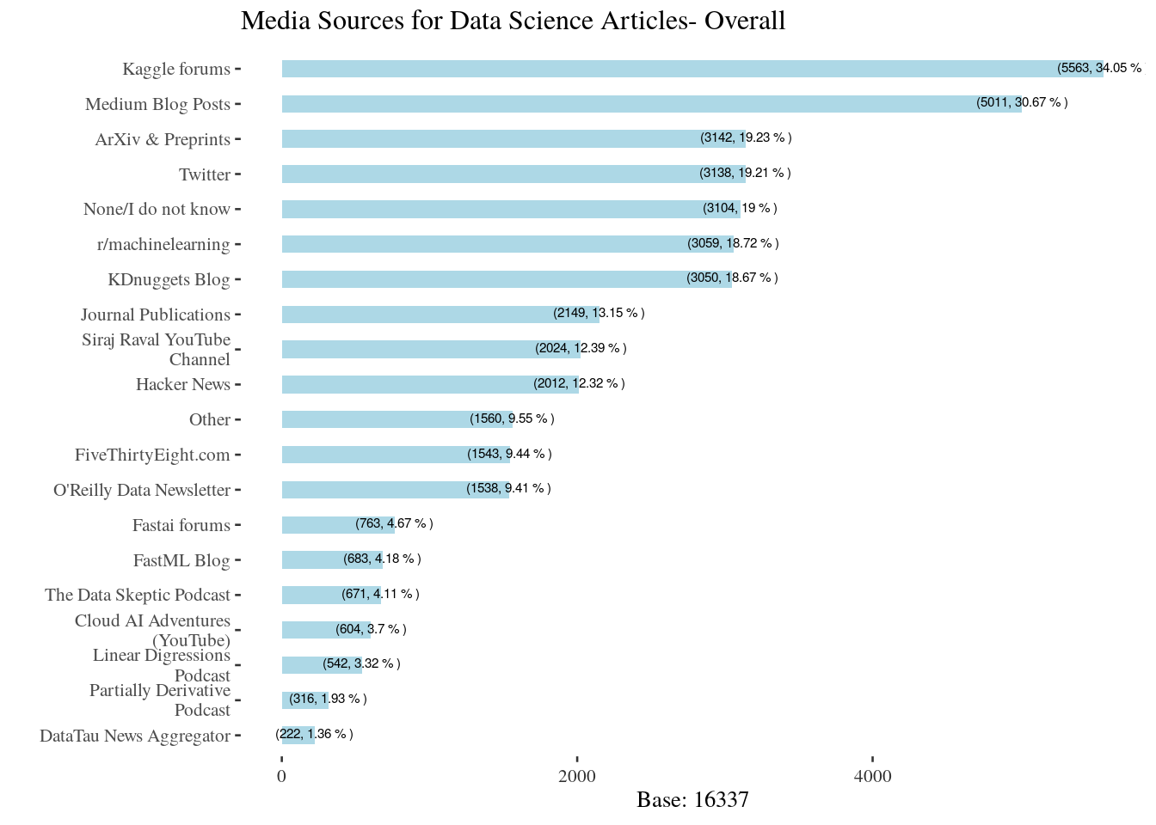
What Else? – ML Blogs/Articles

Slide 22
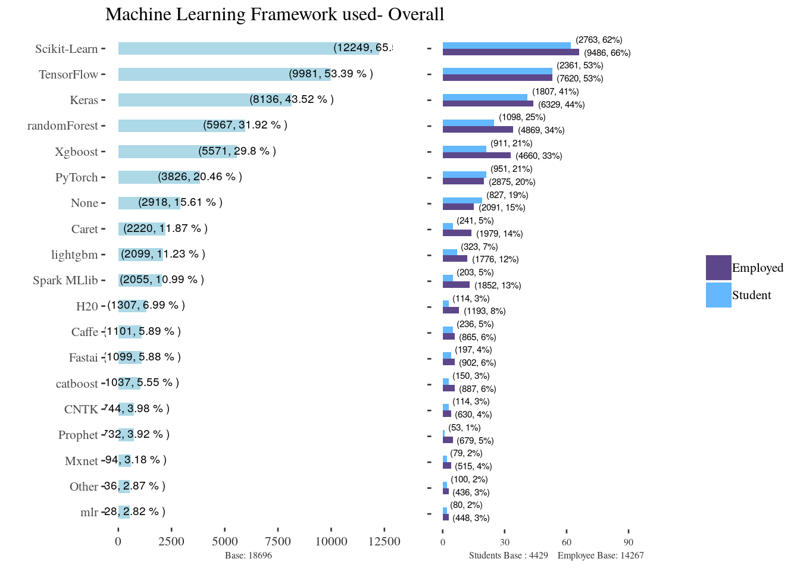
What Else? – ML Frameworks/Libs

Slide 23
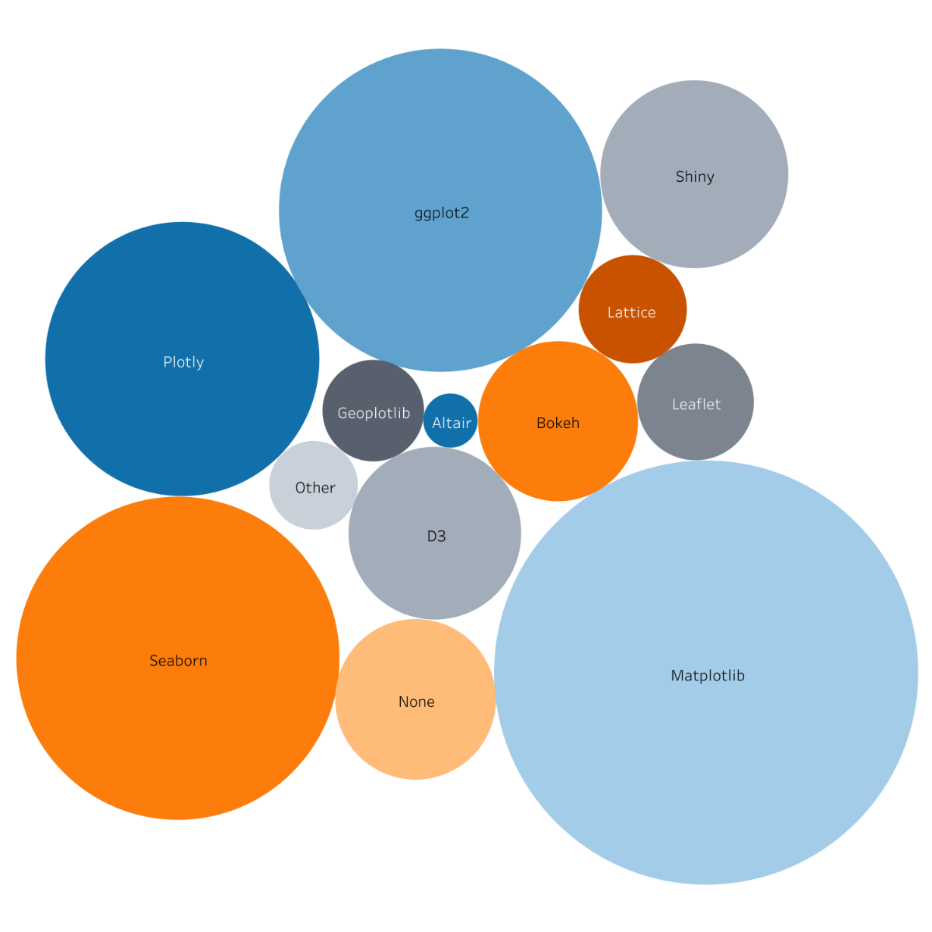
What Else? – Visualization Libs

Slide 24
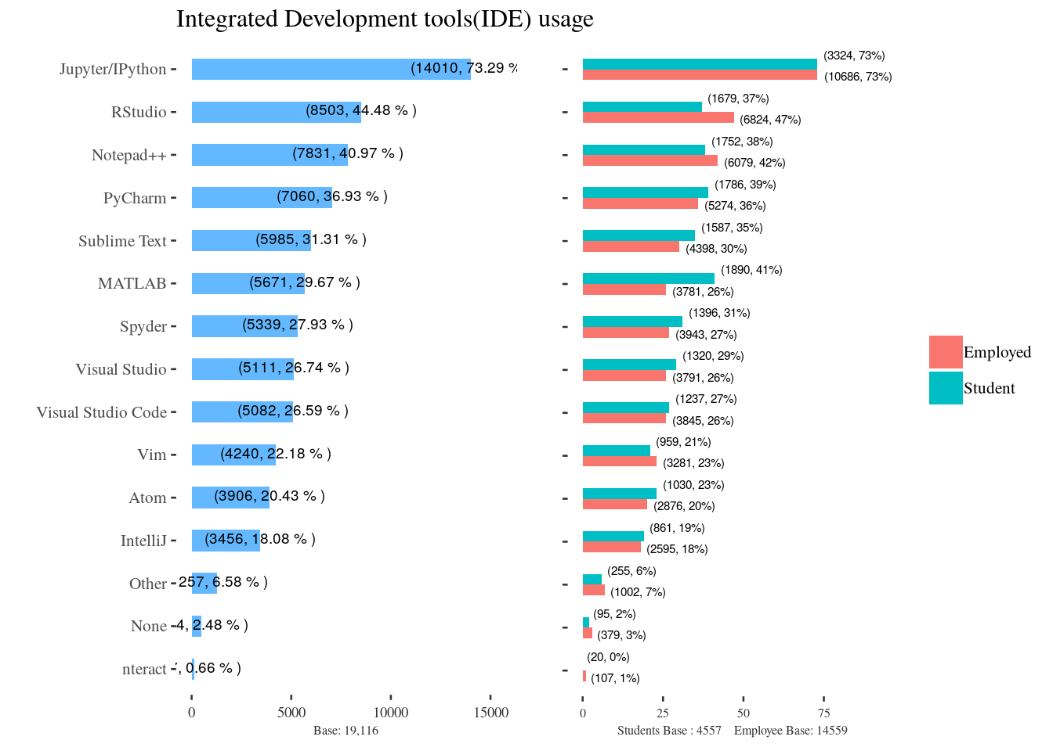
What Else? – ML IDEs

Slide 25
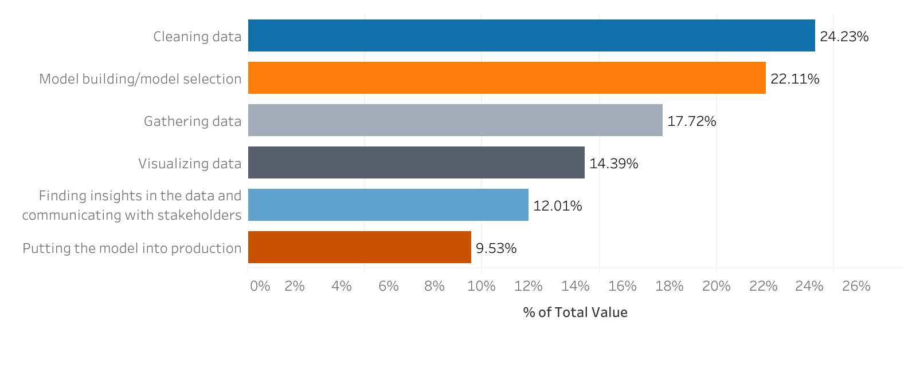
What Else? – Life of a Data Scientist

Slide 26
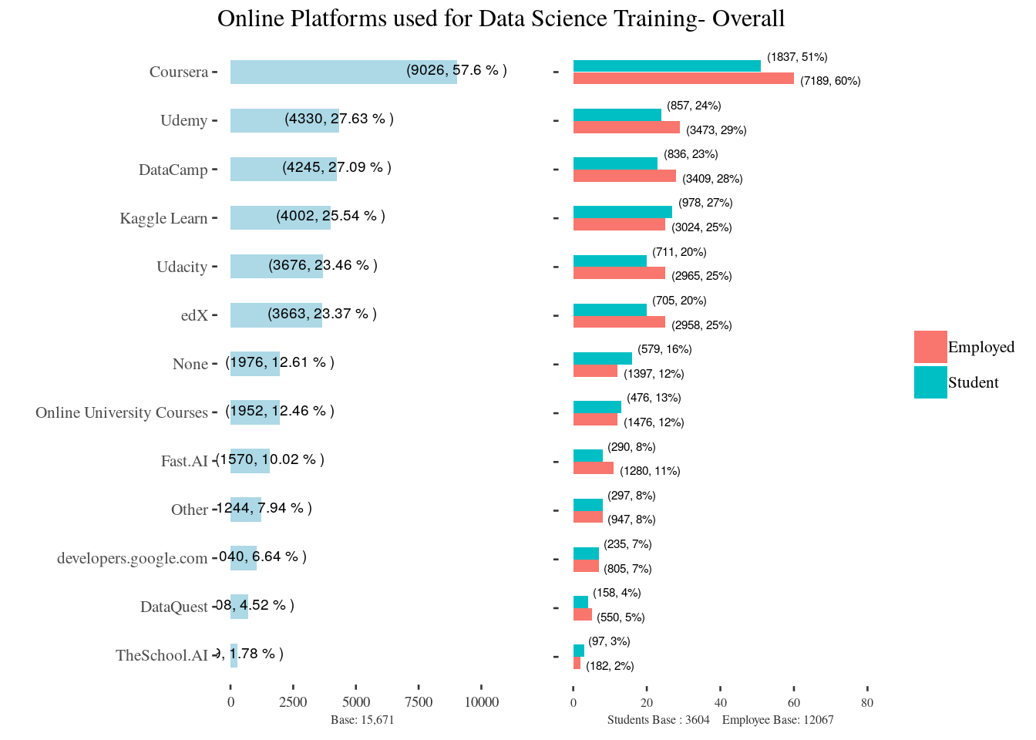
What Else? – Online ML Trainings

Slide 27
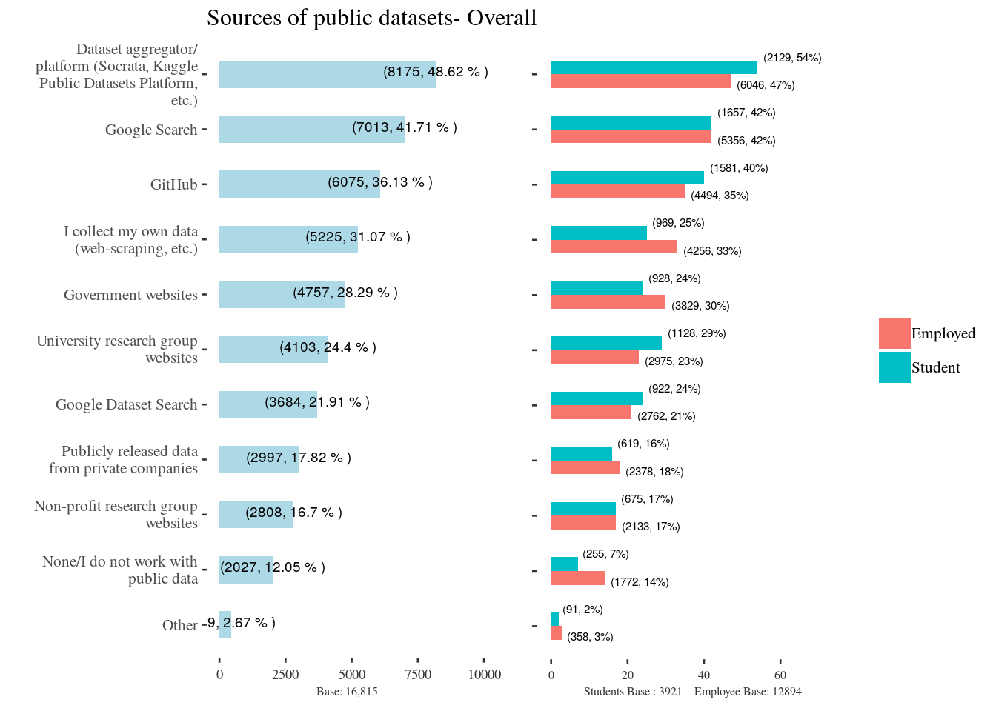
What Else? – Public Data Sets

